Slide 1
Joints
ATHBY Human Biology

Slide 2
Review
List 5 differences between bones and cartilage tissue.
Explain the difference between excretion and elimination.
Explain why blood groups must be determined before receiving blood transfusions.
Summarise cellular respiration, in terms of location, inputs and outputs and ATP production for each of the three steps.

Slide 3
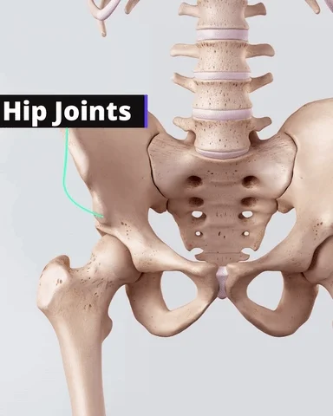
Learning Intentions
Articulations of joints of the skeleton are classified according to their structure or the range of movements permitted.

Slide 4
Success Criteria
Classify joints by movement or shape
Label an anatomical diagram of a synovial joint
Give examples of each type of joint and locate them in the body

Slide 5
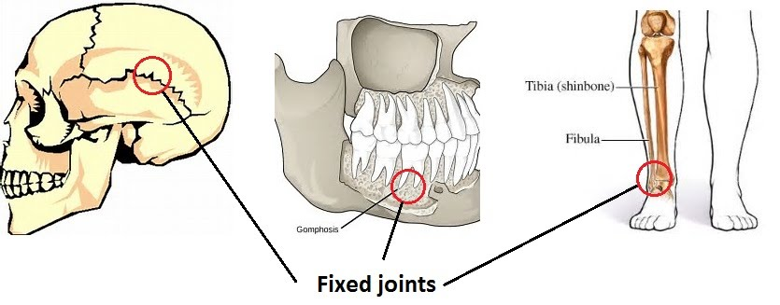
Immovable joint
Tough fibres join bones so they are unable to move

Slide 6
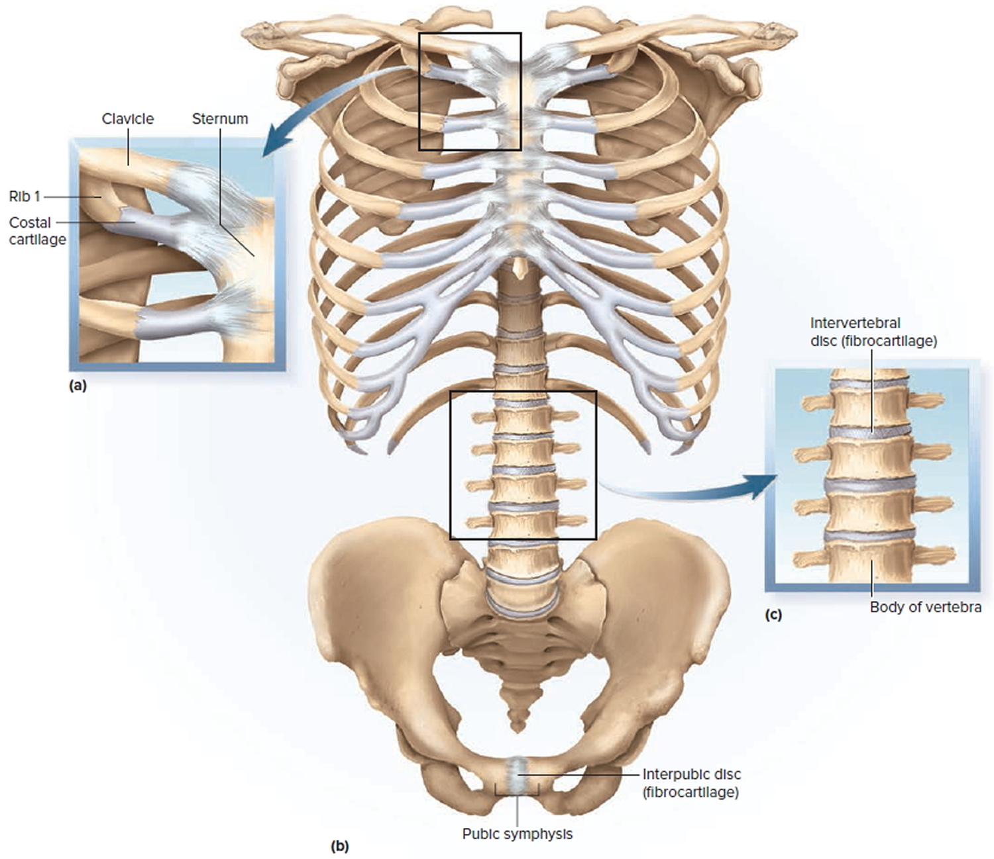
Cartilaginous joint
Bones are connected entirely by fibrous or hyaline cartilage. These joints generally allow more movement than fibrous joints but less movement than synovial joints.

Slide 7
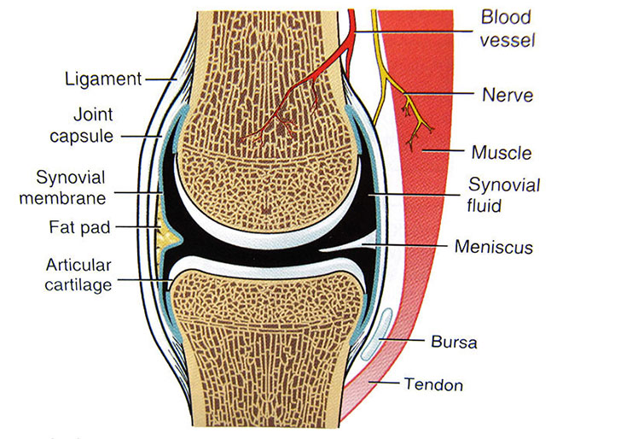
Synovial Joint
A fluid-filled, fibrous capsule allows a range of movements between bones.
Classified according to range of movement.

Slide 8
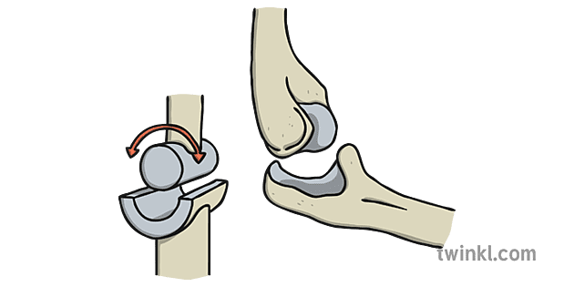
Hinge Joint
allows motion primarily in one plane.

Slide 9
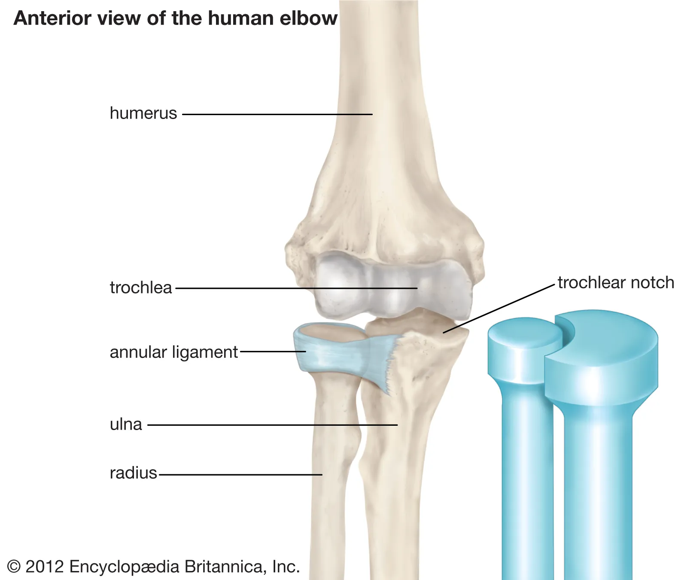
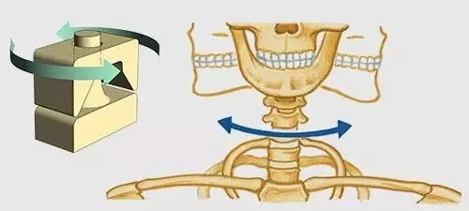
Pivot Joint
allows only rotary movement around a single axis.

Slide 10
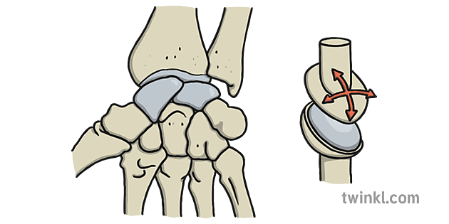
Gliding joint
the articulating surfaces of the involved bones are flat or only slightly curved and glide past one another

Slide 11
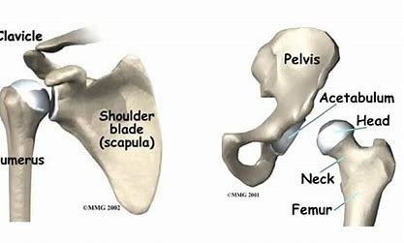
Ball and Socket
The most mobile type of
synovial joint, the end of one
bone is spherical, forming the ball, while the end of the other bone within the joint contains a rounded depression, forming the socket. The ball slides, rolls, and spins within the socket to allow movement of the joint in multiple directions.

Slide 12
Success Criteria
Classify joints by movement or shape
Label an anatomical diagram of a synovial joint
Give examples of each type of joint and locate them in the body

